Slide 1

Loan Prediction Model using machine Learning BY - AMAN KUMAR

Slide 2
PROJECT OVERVIEW
What is Loan Prediction?
Loan prediction involves estimating whether a loan will be approved based on a borrower’s financial and personal details.
Importance of Loan Prediction:
Helps banks and financial institutions automate the loan approval process.
Minimizes manual errors and biases.
Enhances decision-making by identifying eligible customers with higher accuracy.
Role of Machine Learning:
ML models can analyze large datasets and identify patterns to predict loan approvals.

Slide 3

Problem Statement The goal is to predict whether a loan will be approved based on the applicant’s information (like age, income, credit history, etc.). Objective: Develop an ML model that predicts loan status (approved/rejected) using customer information to reduce loan default risks for lenders

Slide 4
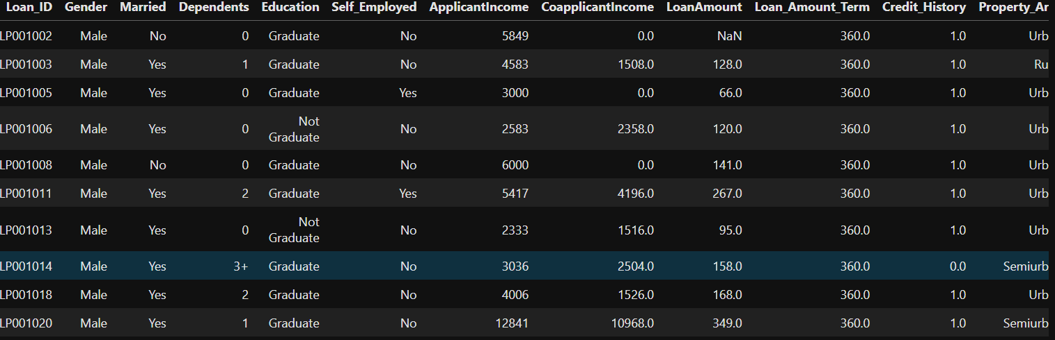
Dataset Description
Size:
Rows: 614 entries
Columns: 13 features
Dependent Variable:
Loan_Status (Approved/Not Approved)
Features:
Independent Variables:
ApplicantIncome, CoapplicantIncome, LoanAmount, Loan_Amount_Term, Credit_History, etc.Categorical variables: Gender, Married, Education, Self_Employed, Property_Area.

Slide 5
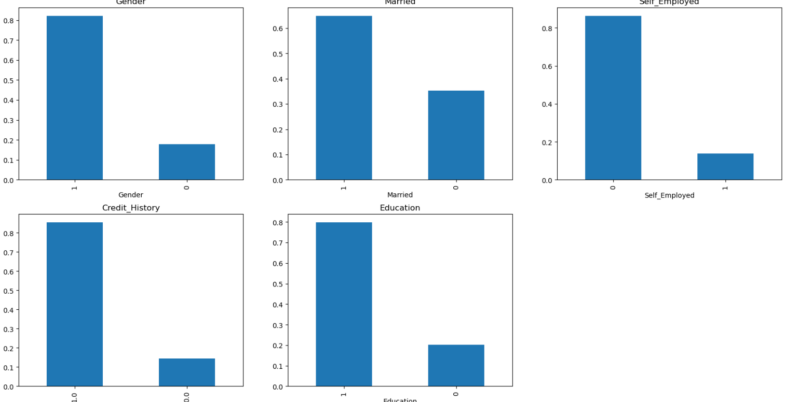
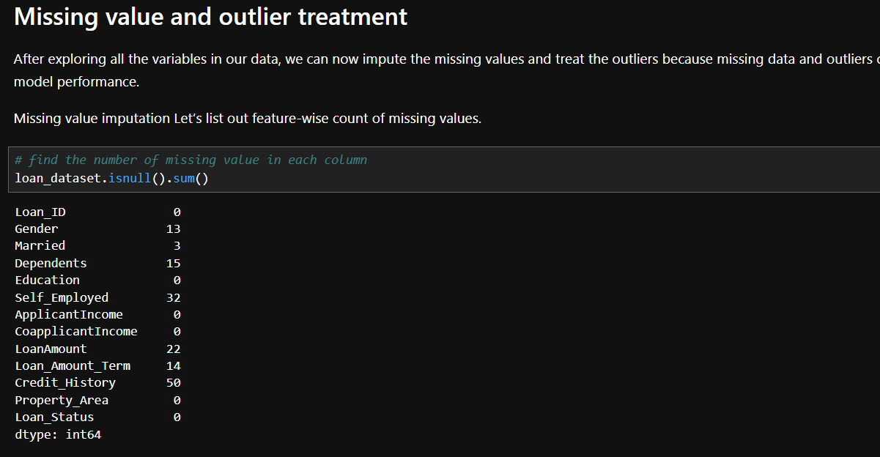
Data Preprocessing
Handling Missing Values:
Categorical features: Imputed missing values using the mode (most frequent value).
Numerical features: Imputed missing values using the median.
Encoding Categorical Variables:
Used Label Encoding for binary variables (e.g., Gender, Married).
Used One-Hot Encoding for multi-category variables (e.g., Property_Area).
Feature Scaling:
Applied Standardization to numerical features like income and loan amount.

Slide 6
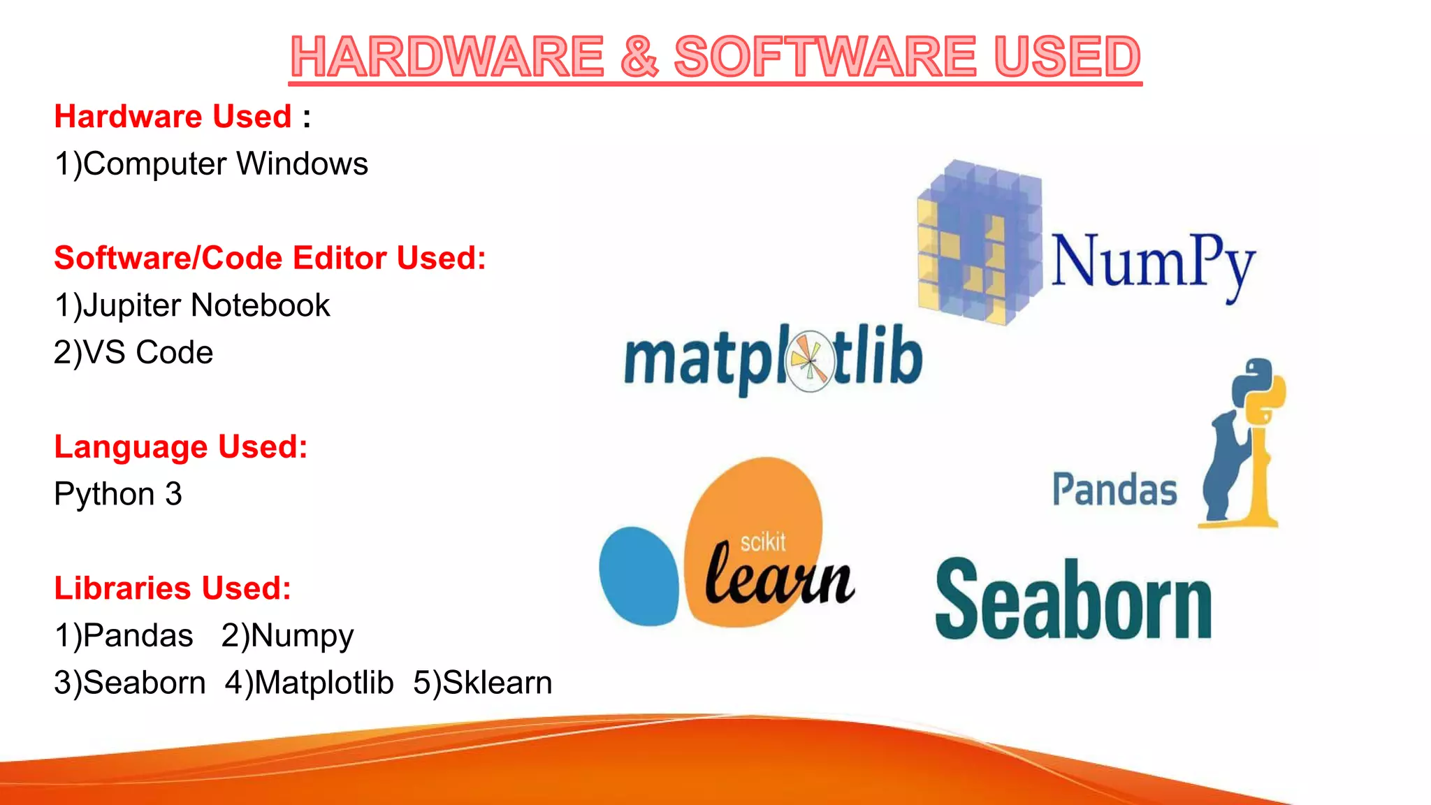

Slide 7
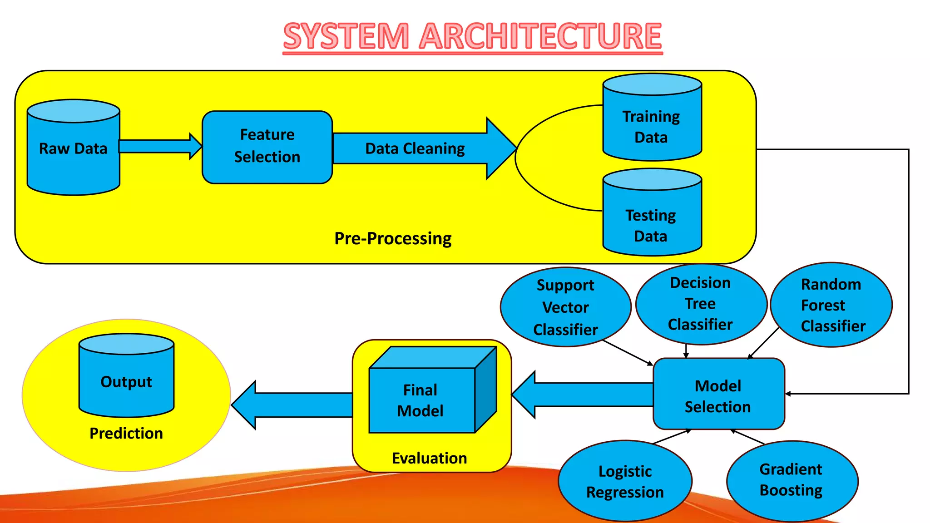

Marketing strategies
Implement personalized engagement strategies
Tailor campaigns to resonate with specific demographics, fostering a sense of relevance and connection
Collaborate with influencers and thought leaders to amplify our brand message

Slide 8
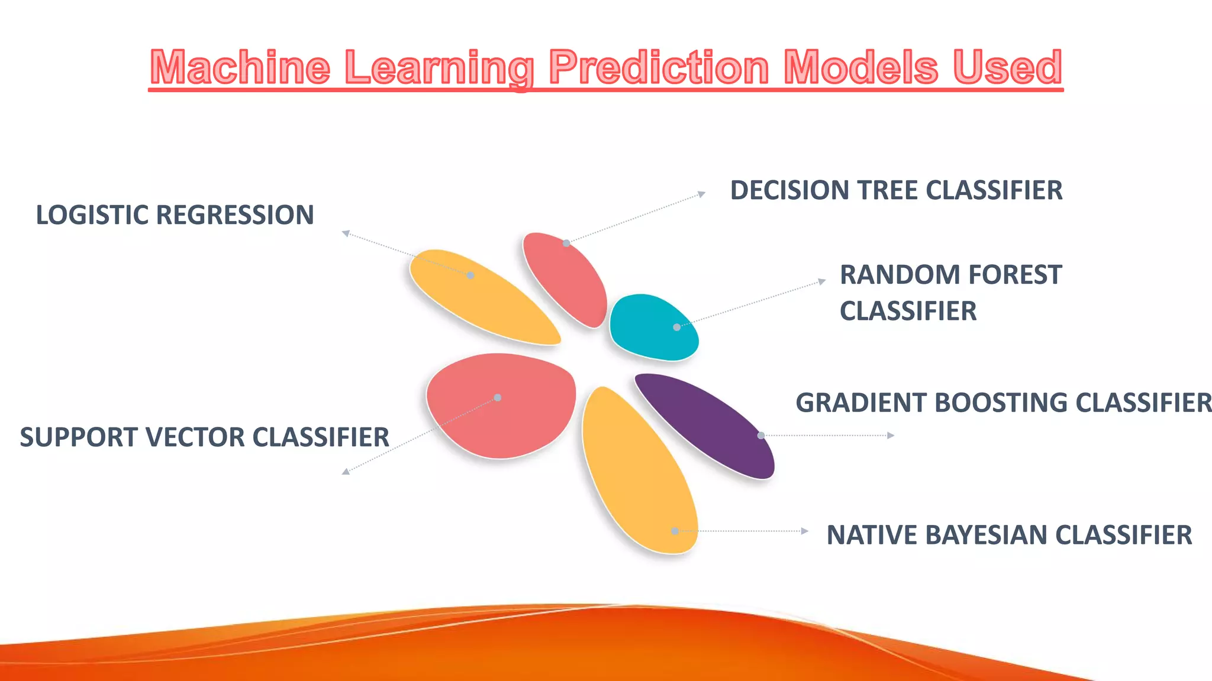
Financial overview
Our financial overview reflects a robust and resilient fiscal performance.
Operating margins have improved, signaling operational efficiency, while strengthening our reserves.
This underscores our commitment to financial stability, positioning us for sustained growth.
Key indicators show consistent revenue growth over the past quarter, attributed to strategic cost management and successful marketing.

Slide 9
Model Selection Algorithms Tested: Logistic Regression: Good for binary classification, interpretable. Decision Tree: Handles non-linear relationships well. Random Forest: Ensemble method to improve performance. Support Vector Machine (SVM): Finds a hyperplane to classify data. Why These Models?: Logistic Regression: Simplicity and interpretability. Random Forest and XGBoost: Powerful for tabular data and can handle missing data effectively. Decision Tree: Handles both categorical and numerical data.

Slide 10
Thank you

